Slide 1
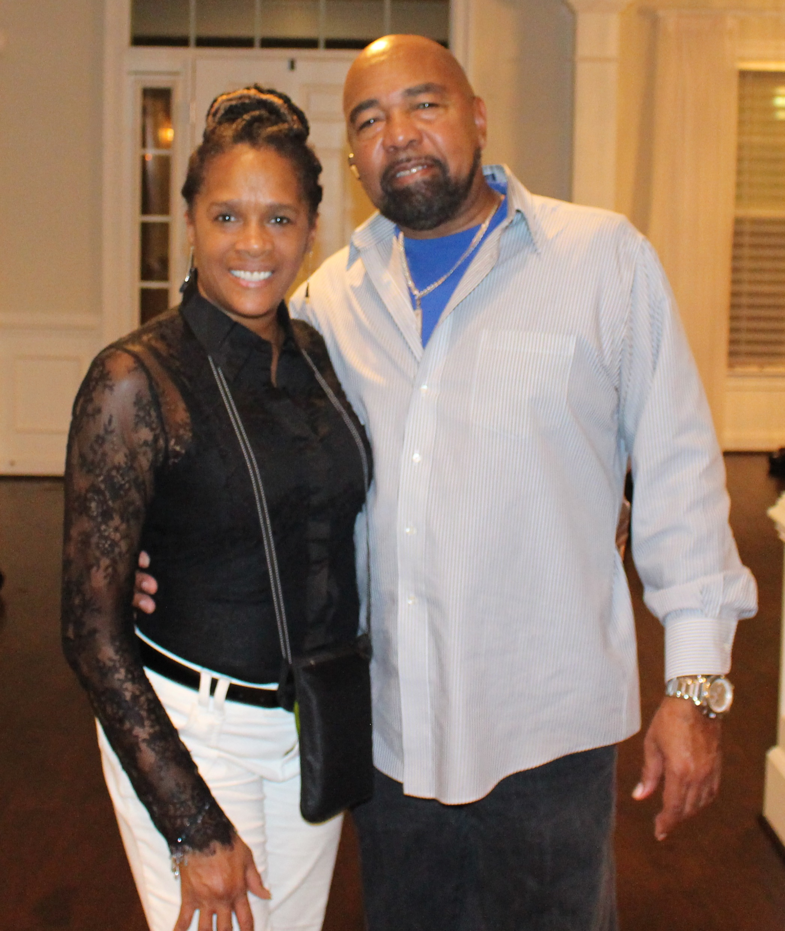
Late Night With Tim and Janice
Media Kit

Slide 2
Late Night with Tim and Janice is a Nationally Syndicated FM Radio show that brings real talk with humor, laughter, and wisdom.
Through personalized life experiences where no subject is off limits, to dynamic interviews with other couples who share their stories and life experiences with humor and insight.
Late Night with Tim and Janice is designed to peak your interest. It will bring inspiration, life strategies, and opportunities to deliberately create the life that you desire, with humor.

Slide 3

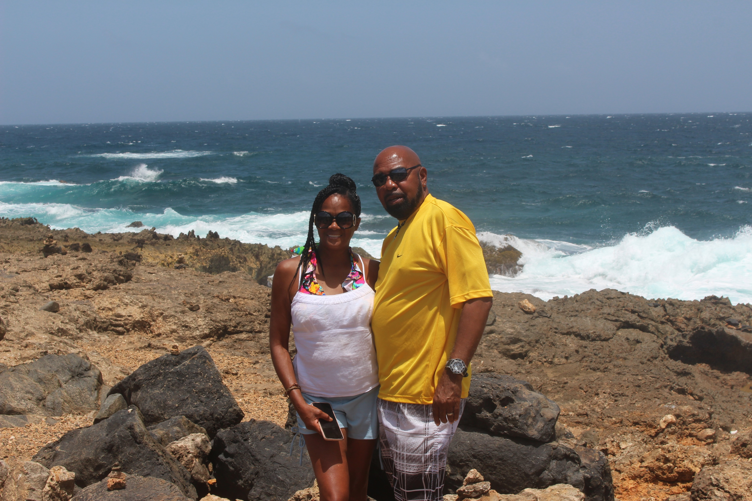
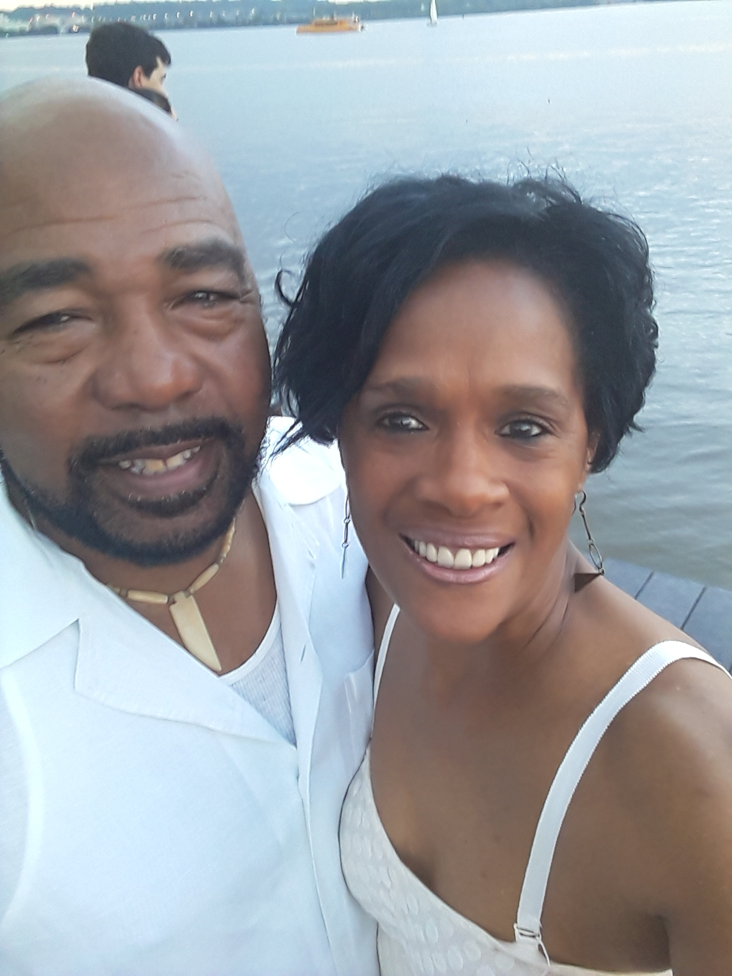
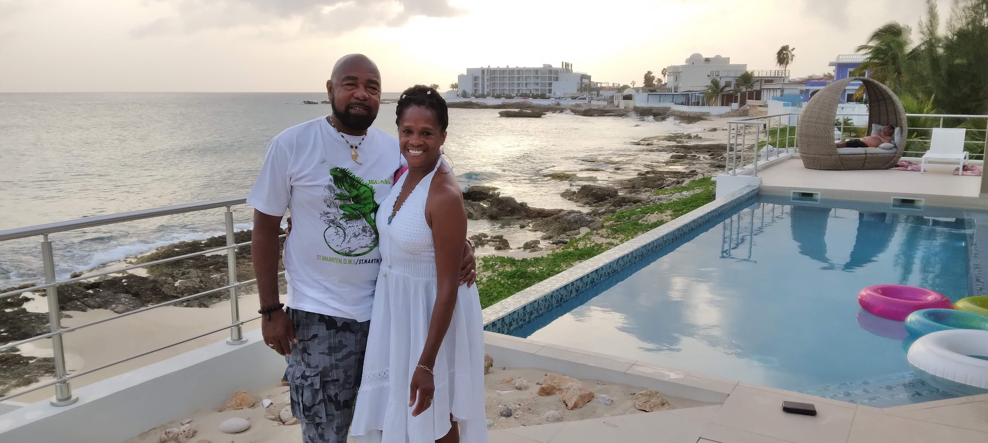
About the Hosts
Tim and Janice Thorne are the dynamic radio hosts of, Late Night with Tim and Janice.
This amazing couple are avid travelers as well as travel specialists who enjoy every opportunity to see new and exciting places. Janice is a Certified Master Life Coach, Author, Speaker and Board Certified in Metaphysics. Timothy is a Regional Director with Surge365, and Deacon at his local church, and proud father and grandfather.
They reside in Wheaton, MD.

Slide 4
Radio / Airing Listing
Airs Wednesday, 11:00 p.m. – 12:00 a.m. ET
Metro Atlanta, Georgia (Dallas, Hiram, Powder Springs, Douglasville)
Station: WDJY 99.1 FM | wdjyfm.com
Highland Heights, Ohio & Kentucky
Station: WTTA 101.2 FM |wttafm.com
TALK10FM.com | Internet only Station www/talk10FM.com
Radio Fairfax | https://tunein.com/Radio-Fairfax (airs 4th Wednesday of each month on Community Radio at 8:00 a.m.)
Summer 2021 Nielson Arbitron Report
Cumulative Listeners to wdjyfm: 655,350

Slide 5
Sponsor Packages
PACKAGE A - $200
Two 30-second ads of your product, company, or service either at the beginning or middle of four (4) Late Night with Tim and Janice episodes airing nationwide. The sponsor will be notified one week prior to the ads being aired on The Late Night with Tim and Janice broadcasts.
One 50-55 minute radio interview with the Host
Targeted promotional “spotlight” posts on social media (Linkedin, Facebook, Instagram) leading up to the scheduled broadcasts.

Slide 6
Terms
Late Night with Tim and Janice episodes can contain more than one ad (Package A) as long as there is no competing company, product or service.
Full payment is required at the beginning of the agreement with Late Night with Tim and Janice hosts for the ad and guest interview.
All ads are written by the guest and recorded by a Late Night with Tim and Janice representative. Guests are also welcome to provide a written and recorded ad directly to the host.
All guest interviews are pre-recorded before airing. Host utilizes a professional Musysic microphone and guests are encouraged to utilize Free HD Conference Call which has high definition recording capabilities.

Slide 7
IT IS OUR PLEASURE TO PARTNER WITH YOU IN SHARING WHAT YOU DO WITH THE WORLD AND HOW YOU ARE MAKING AN IMPACT IN YOUR COMMUNITY.
Contact Information
www.BeU2thefull.com/FMsponsorships
Tim and Janice Thorne

