Slide 1
BeU2thefull Media Kit
Janice Thorne | www.beU2thefull.com | 240-706-1297

Slide 2
A Nationally Syndicated FM Radio show designed to help individuals re-create new patterns of living through how they think and the habitual conditioning of their minds. BeU2thefull’s goal is to create mental mastery in the lives of those who align with this powerful message.
Our focus is to teach, educate and bring awareness to people that, “For as a man thinks within himself, so is he (or she).” Proverbs 23:7. Through personalized messages by the host, or dynamic interviews with individuals who have garnered great results in their life through the art of mental mastery, we desire to bring to our audience messages that undergird the power of mental mastery. When you control your thoughts, you control your life.

Slide 3
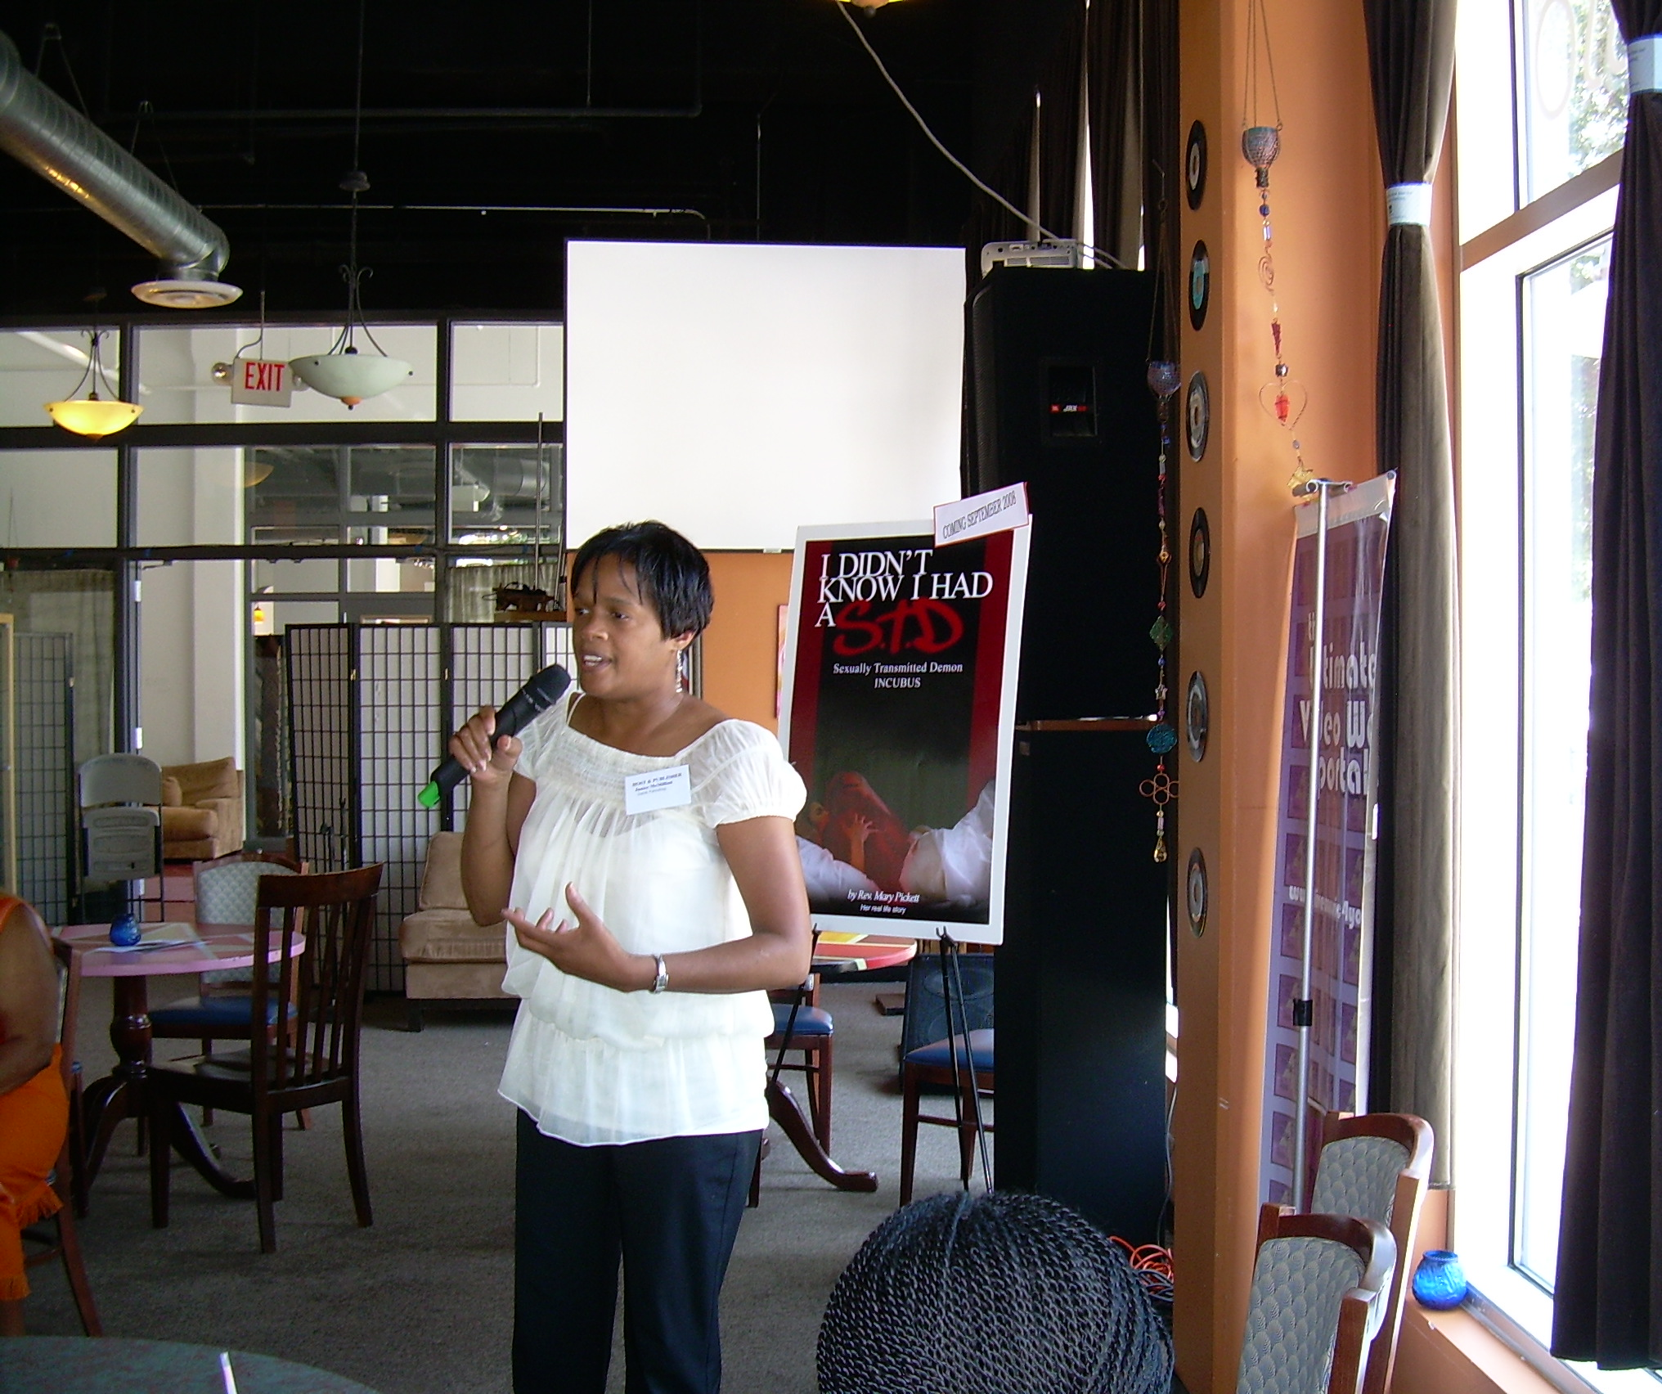
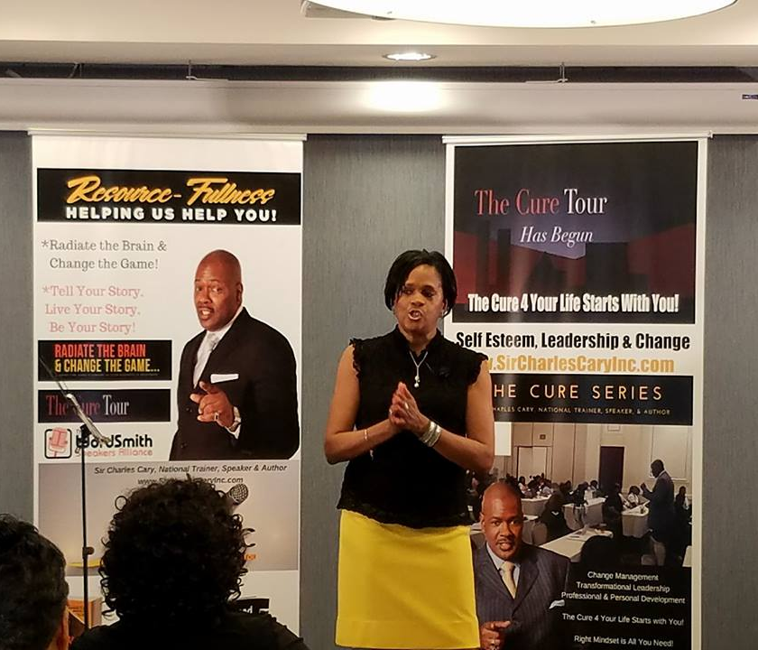
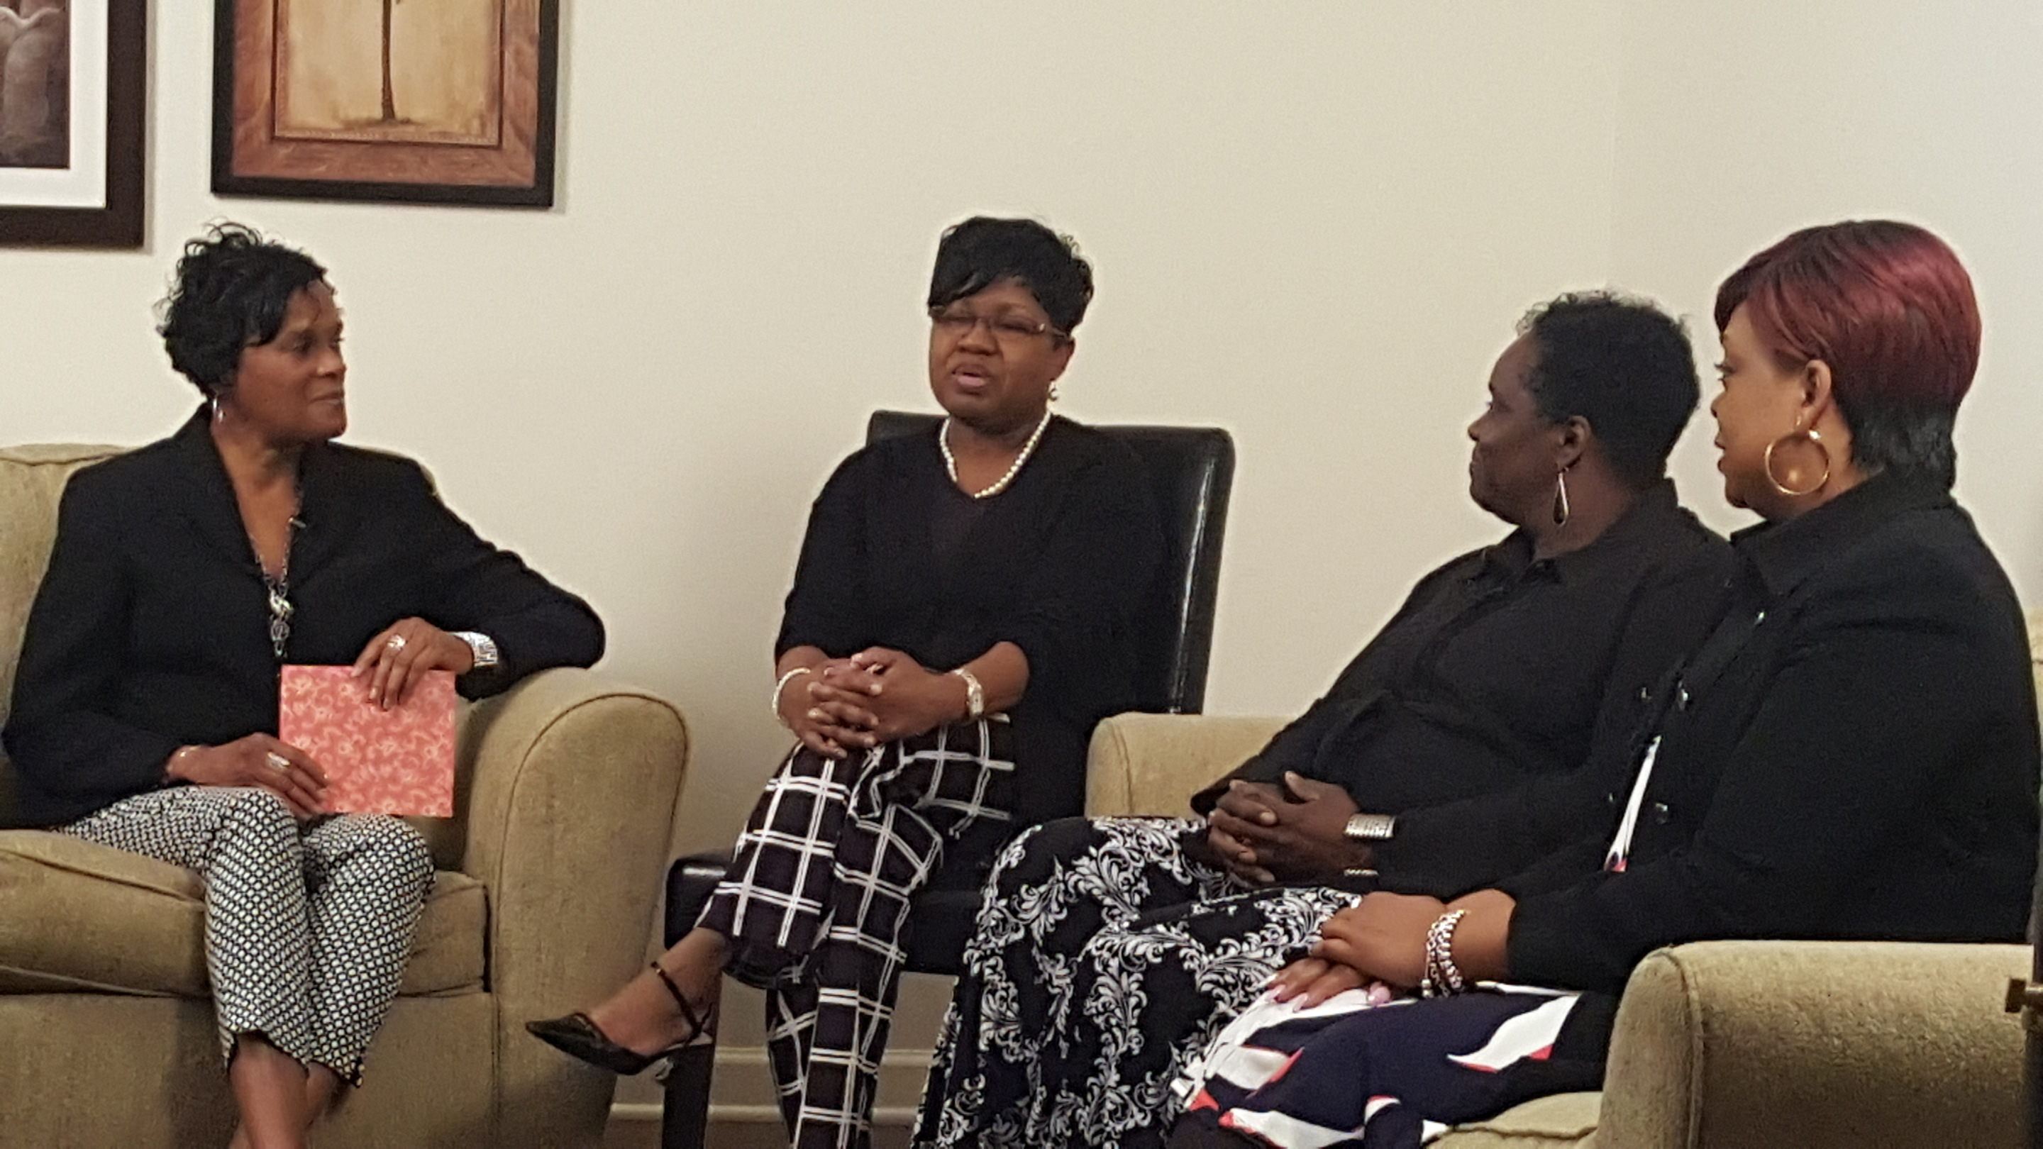
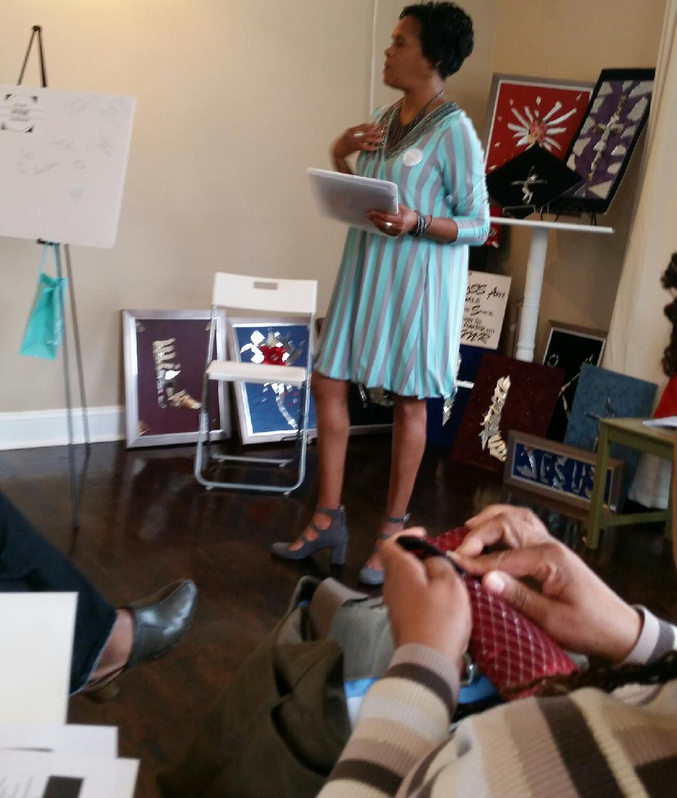
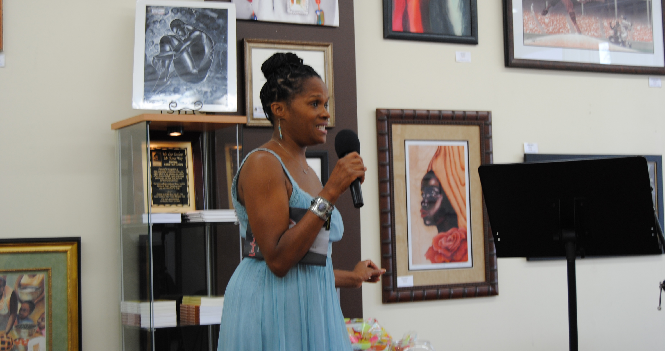
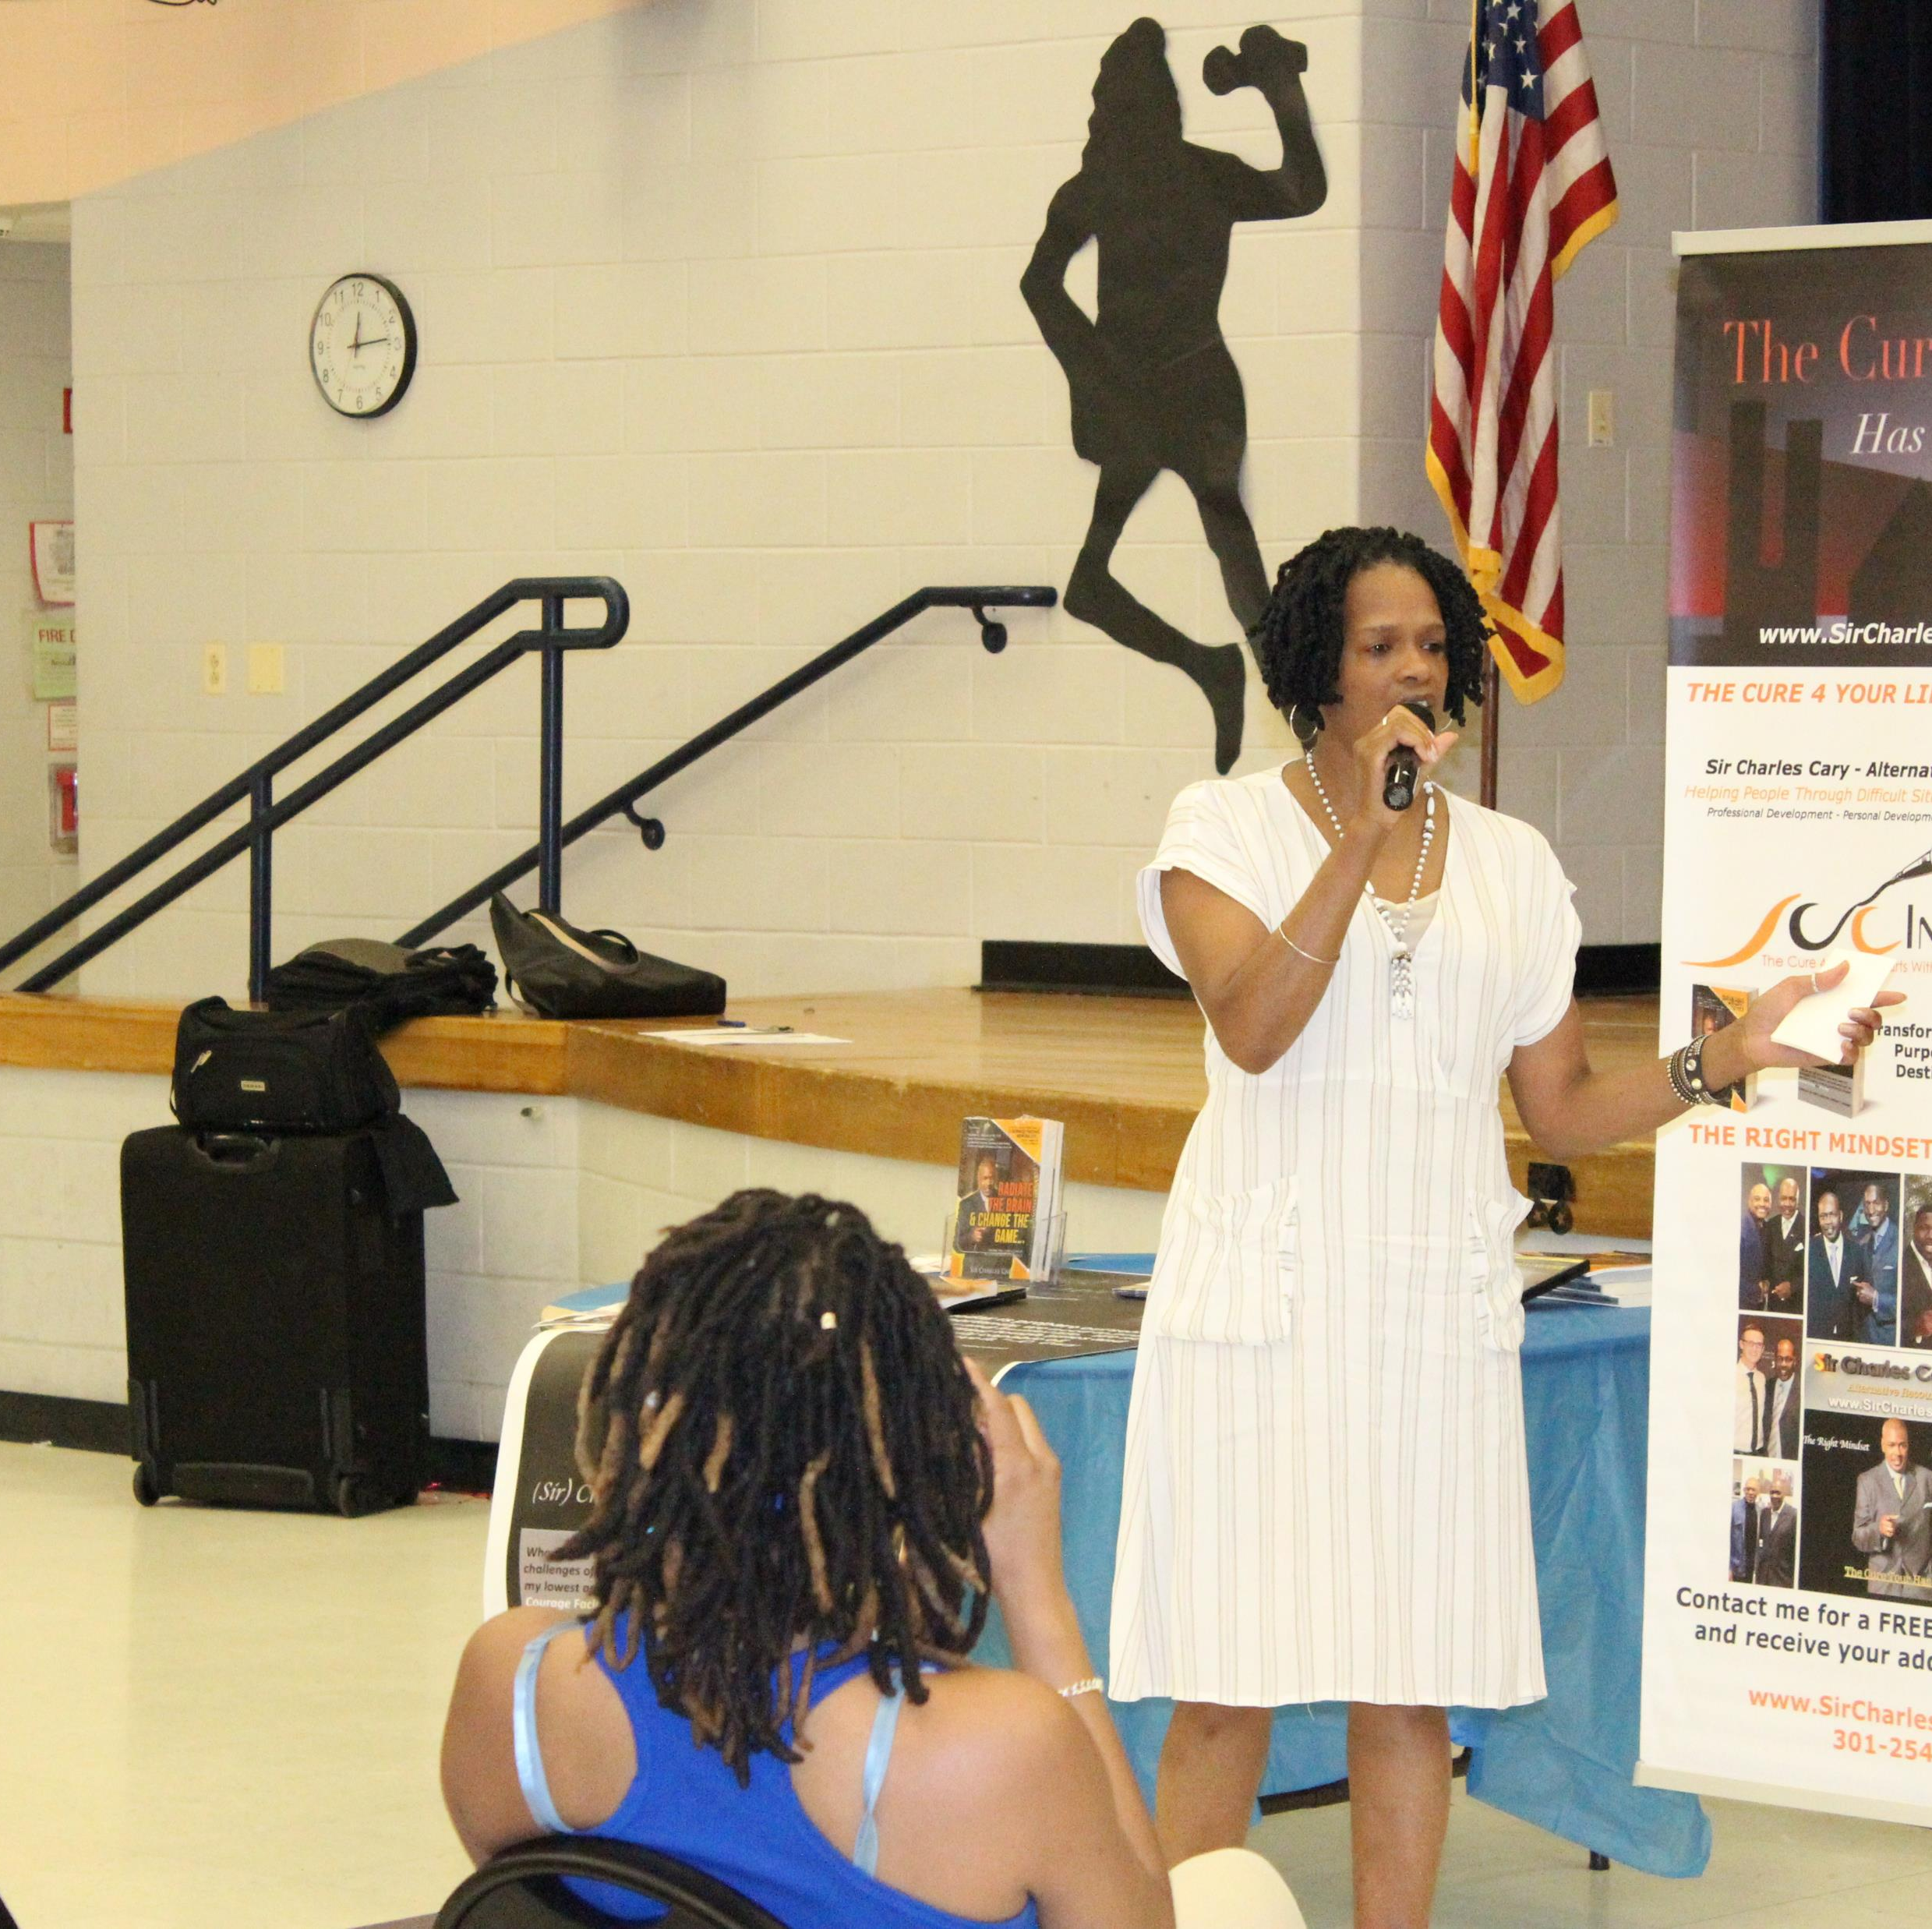
About the Host
This is accomplished by breaking old mental paradigms that have been constructed through traditions, societal programming, culture, church, etc. that have kept so many individuals stuck and living from a limited perspective.
BeU2TheFull encourages individuals to be mentally masterful in their creation of new life experiences.
Janice has authored and published four books, Bruised, Broken and Blessed, Let the Redeemed of the Lord Say So, Unafraid and Fifty: Pushing the Reset Button on Your Life and The Joy Tour: Optimum Success in the Workplace and other anthology projects.
Janice is the visionary behind BeU2TheFull. She is a Certified Master Life Coach, Author, Writer, Speaker and Board Certified in Metaphysics. Her journey has led her to live from a more awakened perspective through the dismantling of old auto pilot beliefs and programs. Through her renewal process she felt there must be others like her who desire a fresh beginning as well.
BEU2theFull, is the space for that individual to become a better version of themselves so that they can let go of the programming, paradigms, and habitual beliefs that no longer serve the person. The vision is to transform the way individuals have been programmed to think and do life.

Slide 4
RADIO
AIRING LIST
Metro Atlanta, Georgia (Dallas, Hiram, Powder Springs, Douglasville)
Station: WDJY 99.1 FM | wdjyfm.com
Highland Heights, Ohio & Kentucky
Station: WTTA 101.2 FM |wttafm.com
Radio Fairfax | https://tunein.com/Radio-Fairfax (airs 4th Wednesday of each month on Community Radio at 8:00 a.m.)
Talk10 | Internet Only FM Station www.talk10FM.com
Airs Thursdays 12pm EST in the below cities and more. Mon – Fri 7-8pm, 11pm-12am, 5-6am
Summer 2021 Nielson Arbitron Report
Cumulative Listeners to wdjyfm: 655,350
Day time listeners for my show: 12:00 pm – 1:00 pm, Thursdays – 27,900
Day time internet listeners for my show: 12:00 pm – 1:00 pm., Thursdays – 1,600

Slide 5
PODCAST
Podcast broadcasts are available on the following streaming platforms:
Anchor
Apple
Google Play
iTunes
Overcast
Pocket
Public
Spotify

Slide 6
SPONSOR PACKAGES
PACKAGE A - $500
Three (3) separate 30-second ads (played in various rotations) either at the beginning or middle of 10 BeU2theFull episodes and 3 other Network shows airing nationwide. The Sponsor will be notified one week prior to the ads being aired on The BeU2thefull broadcasts.
One 50-55 minute radio interview with the Host
Promotional snippet of the interview for your website or other platform.
Pre-introduction on Zoom during the month of scheduled broadcast.
Future repeated replays on all podcast streams and the FM radio stations.
Need a ghostwriter for your book/ebook? Every business, service provider, coach, company owner or storyteller should have one. The Host/who is a ghostwriter, will work with you to start your book with 2 full chapters. The remaining chapters up to 5 are fee based and are part of her Tell Your Story in 5 Ghostwriting package.

Slide 7
SPONSOR PACKAGES
PACKAGE B - $300
Two separate 30-second ads (played in rotation) either at the beginning or middle of 7 BeU2theFull episodes airing nationwide. Sponsor will be notified one week prior to the ads being aired on BeU2thefull broadcasts.
One 50-55 minute radio interview with the Host
Promotional snippet of the interview for your website or other platform.
Targeted promotional “spotlight” posts on social media (Linkedin, Facebook, Instagram) leading up to the scheduled broadcasts.

Slide 8
SPONSOR PACKAGES
PACKAGE C - $200
Two separate 30-second ads either at the beginning or middle of five BeU2theFull episodes airing nationwide
One ½ hour radio interview with the Host
Pre-introduction on Zoom highlighting your product or service

Slide 9
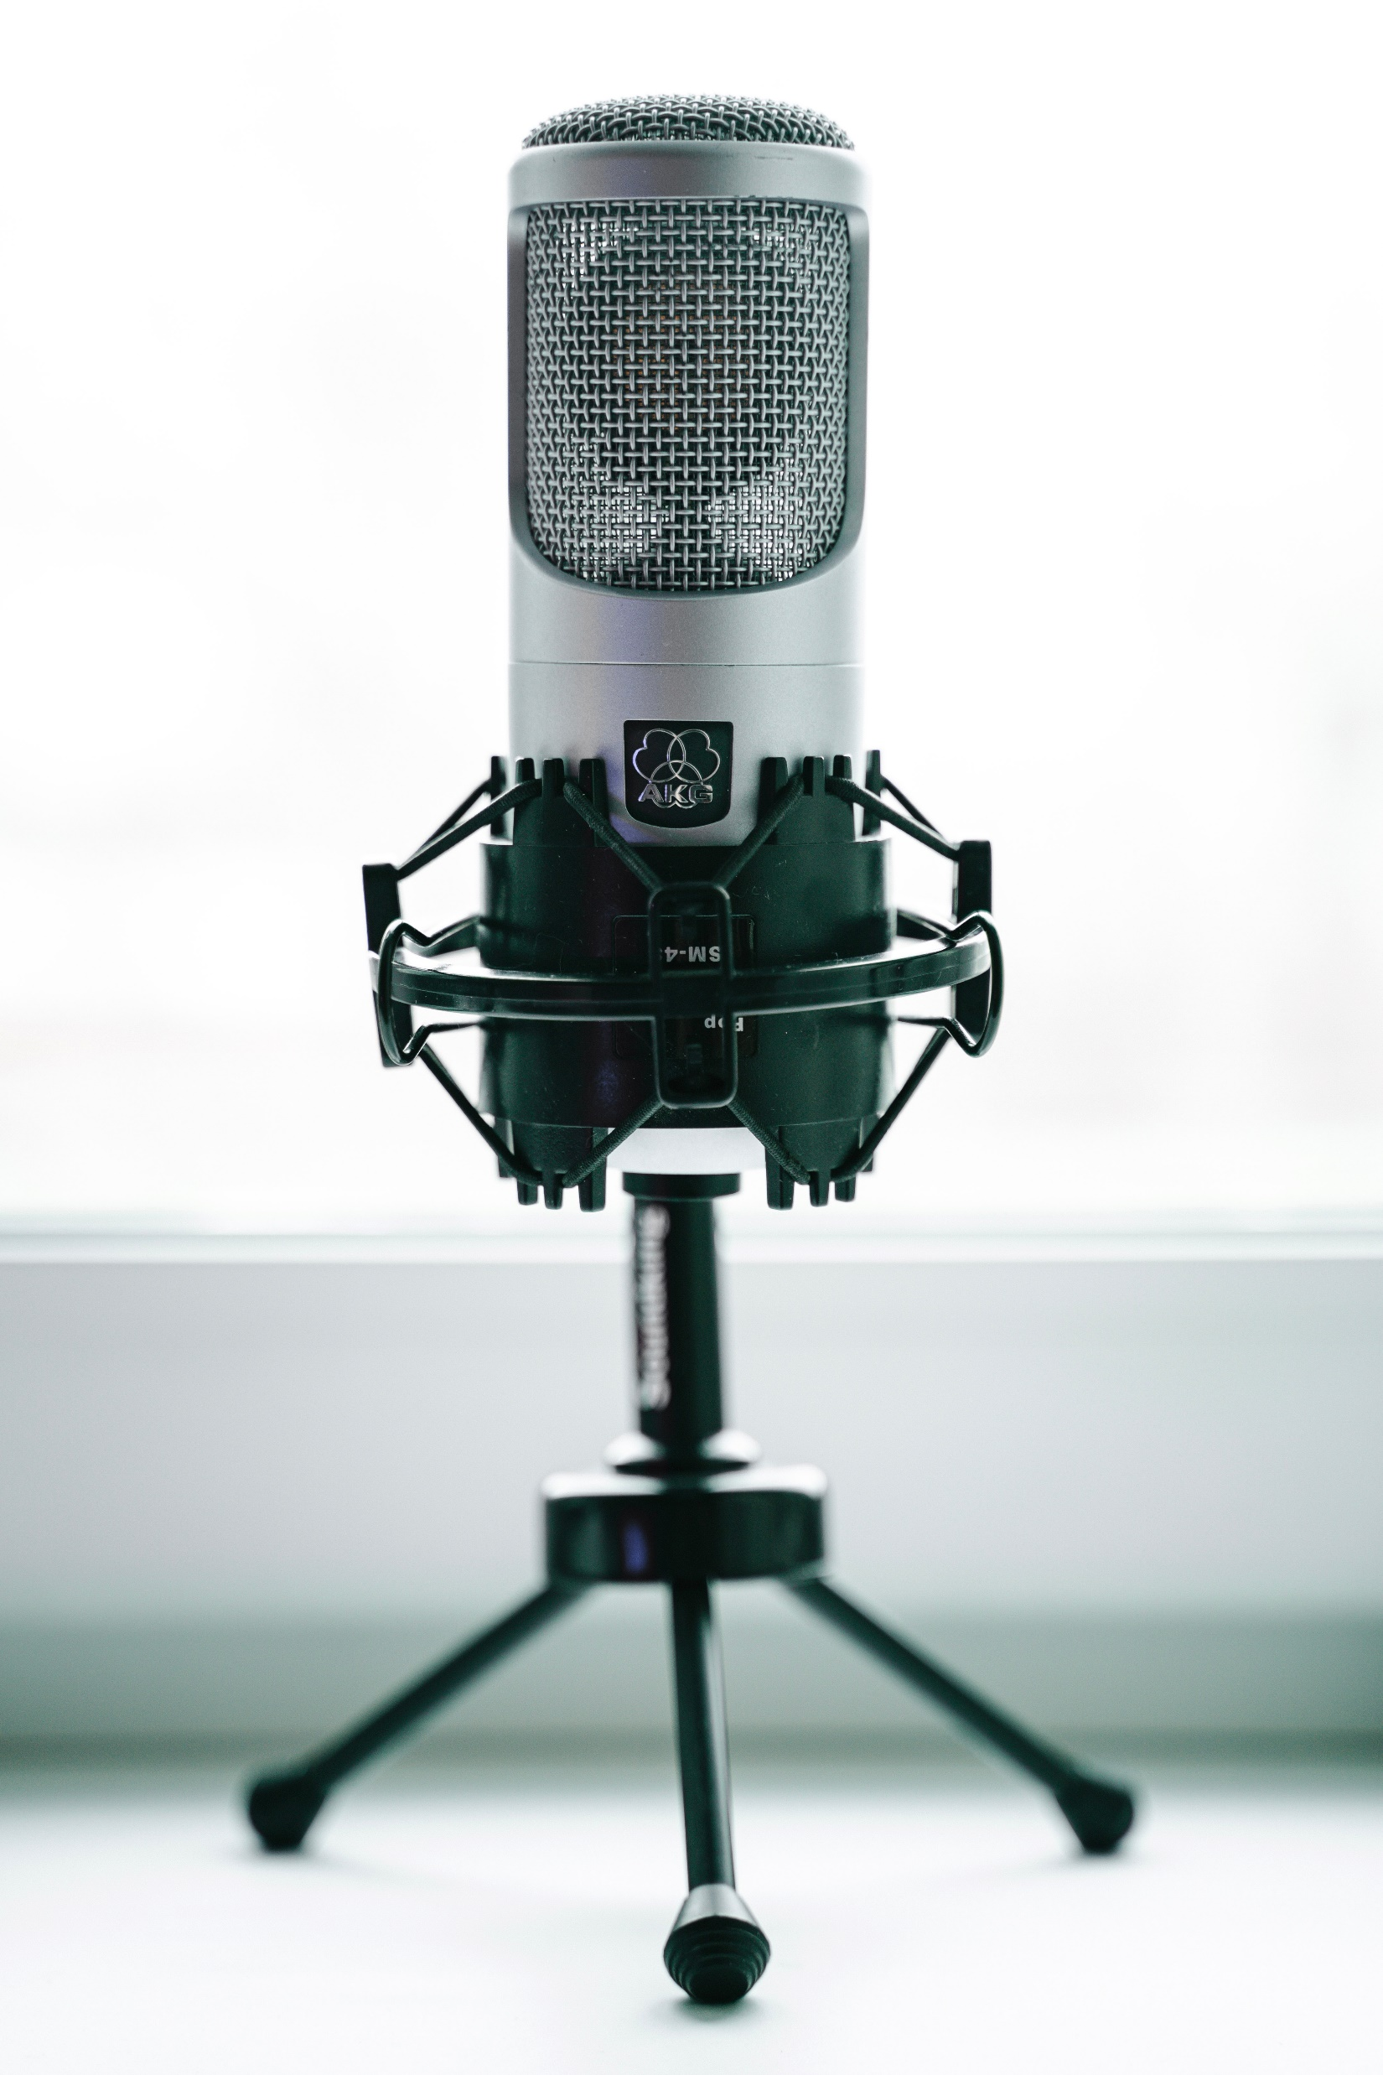
Terms
1-hour BeU2theFull episodes can contain more than one ad (Package A and B only) as long as there is no competing company, product or service.
Full payment is required for all packages at the beginning of the agreement with BeU2thefull for the ad and request for sponsorship and guest interviews.
All ads are written by the guest and recorded by a BeU2theFull representative. Guests are also welcome to provide a written and recorded ad directly to BeU2theFull however, the full amount must be paid prior to the ad airing.
All guest interviews are pre-recorded before airing. Host utilizes a professional Musysic microphone and guests are encouraged to utilize Free HD Conference Call which has high definition recording capabilities.

Slide 10
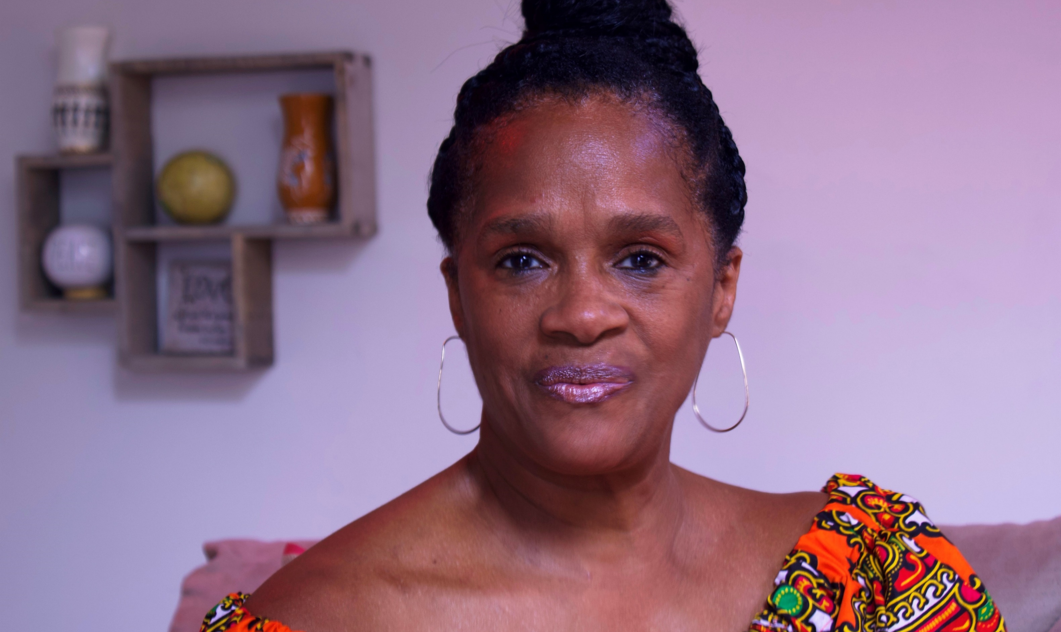
Contact Information
www.beU2thefull.com/FMsponsorships
Janice Thorne | 240-706-1297
IT IS MY PLEASURE TO PARTNER WITH YOU IN SHARING WITH THE WORLD WHAT YOU DO AND HOW YOU ARE MAKING AN IMPACT IN YOUR COMMUNITY.

