Slide 1
BeU2thefull Media Kit
Janice Thorne | www.beU2thefull.com | 240-706-1297

Slide 2
A Nationally Syndicated FM Radio show designed to help individuals re-create new patterns of living through how they think and the habitual conditioning of their minds. BeU2thefull’s goal is to create mental mastery in the lives of those who align with this powerful message.
Our focus is to teach, educate and bring awareness to people that, “For as a man thinks within himself, so is he (or she).” Proverbs 23:7. Through personalized messages by the host, or dynamic interviews with individuals who have garnered great results in their life through the art of mental mastery, we desire to share with our audience that when you control your thoughts, you control your life.

Slide 3
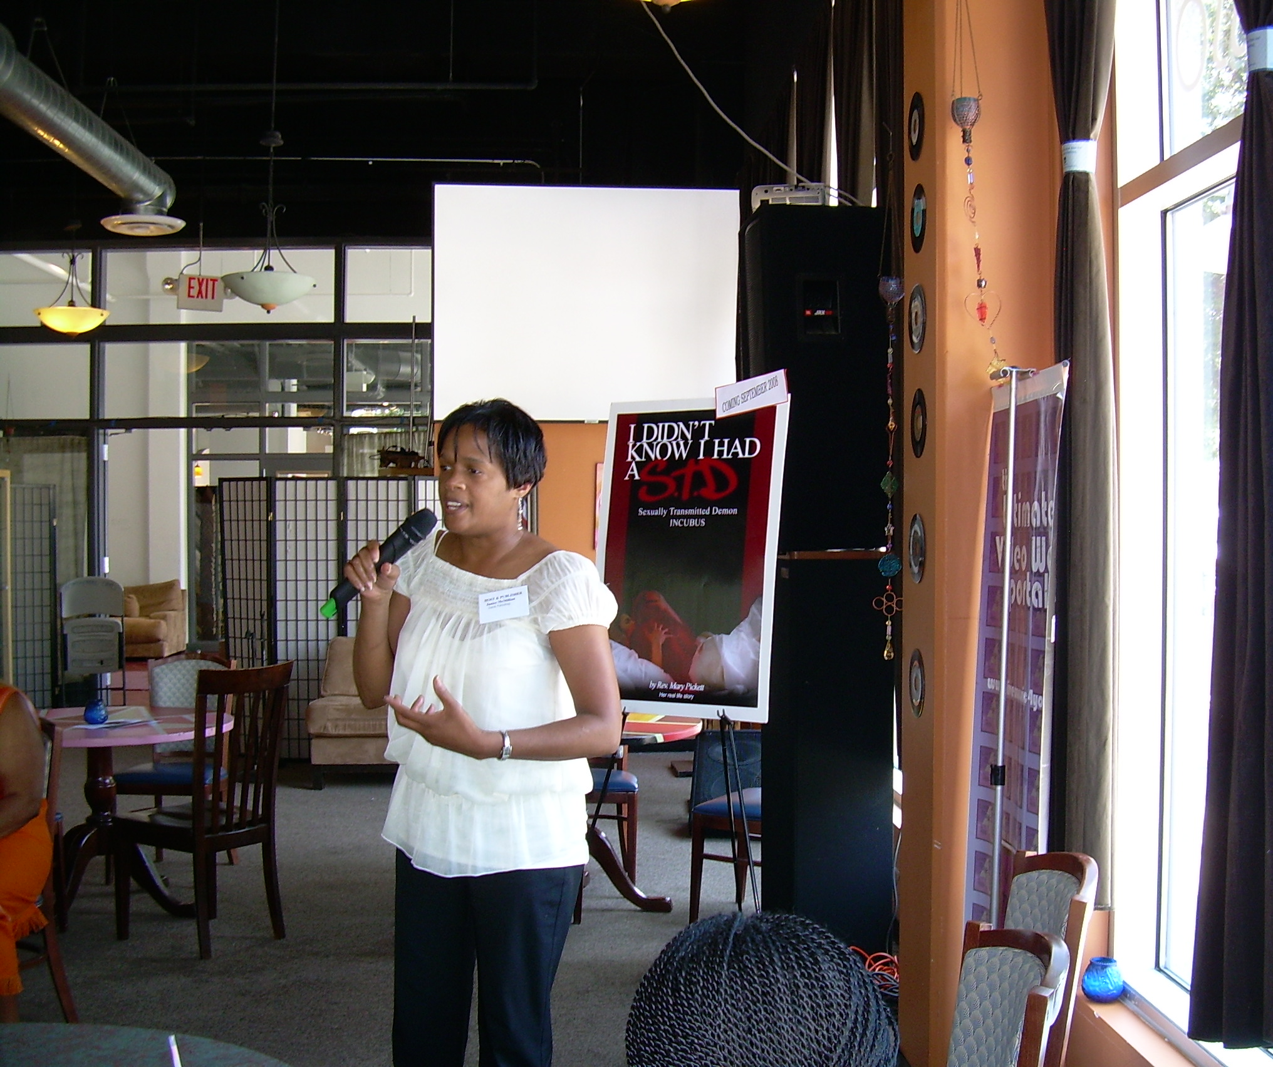
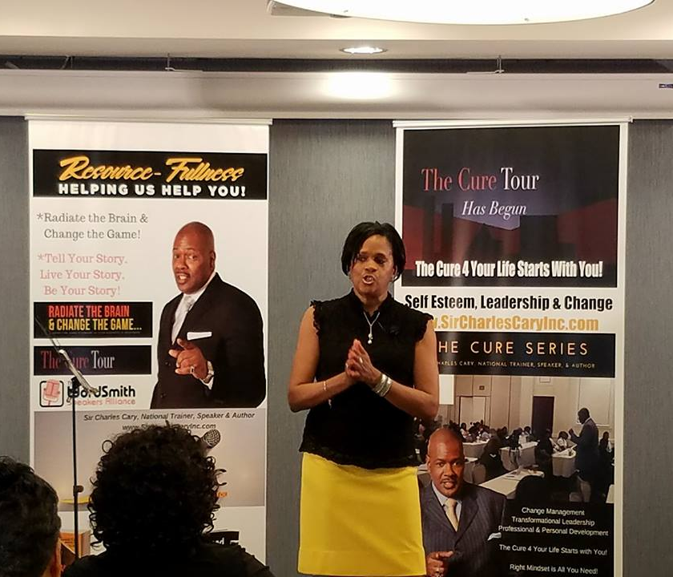
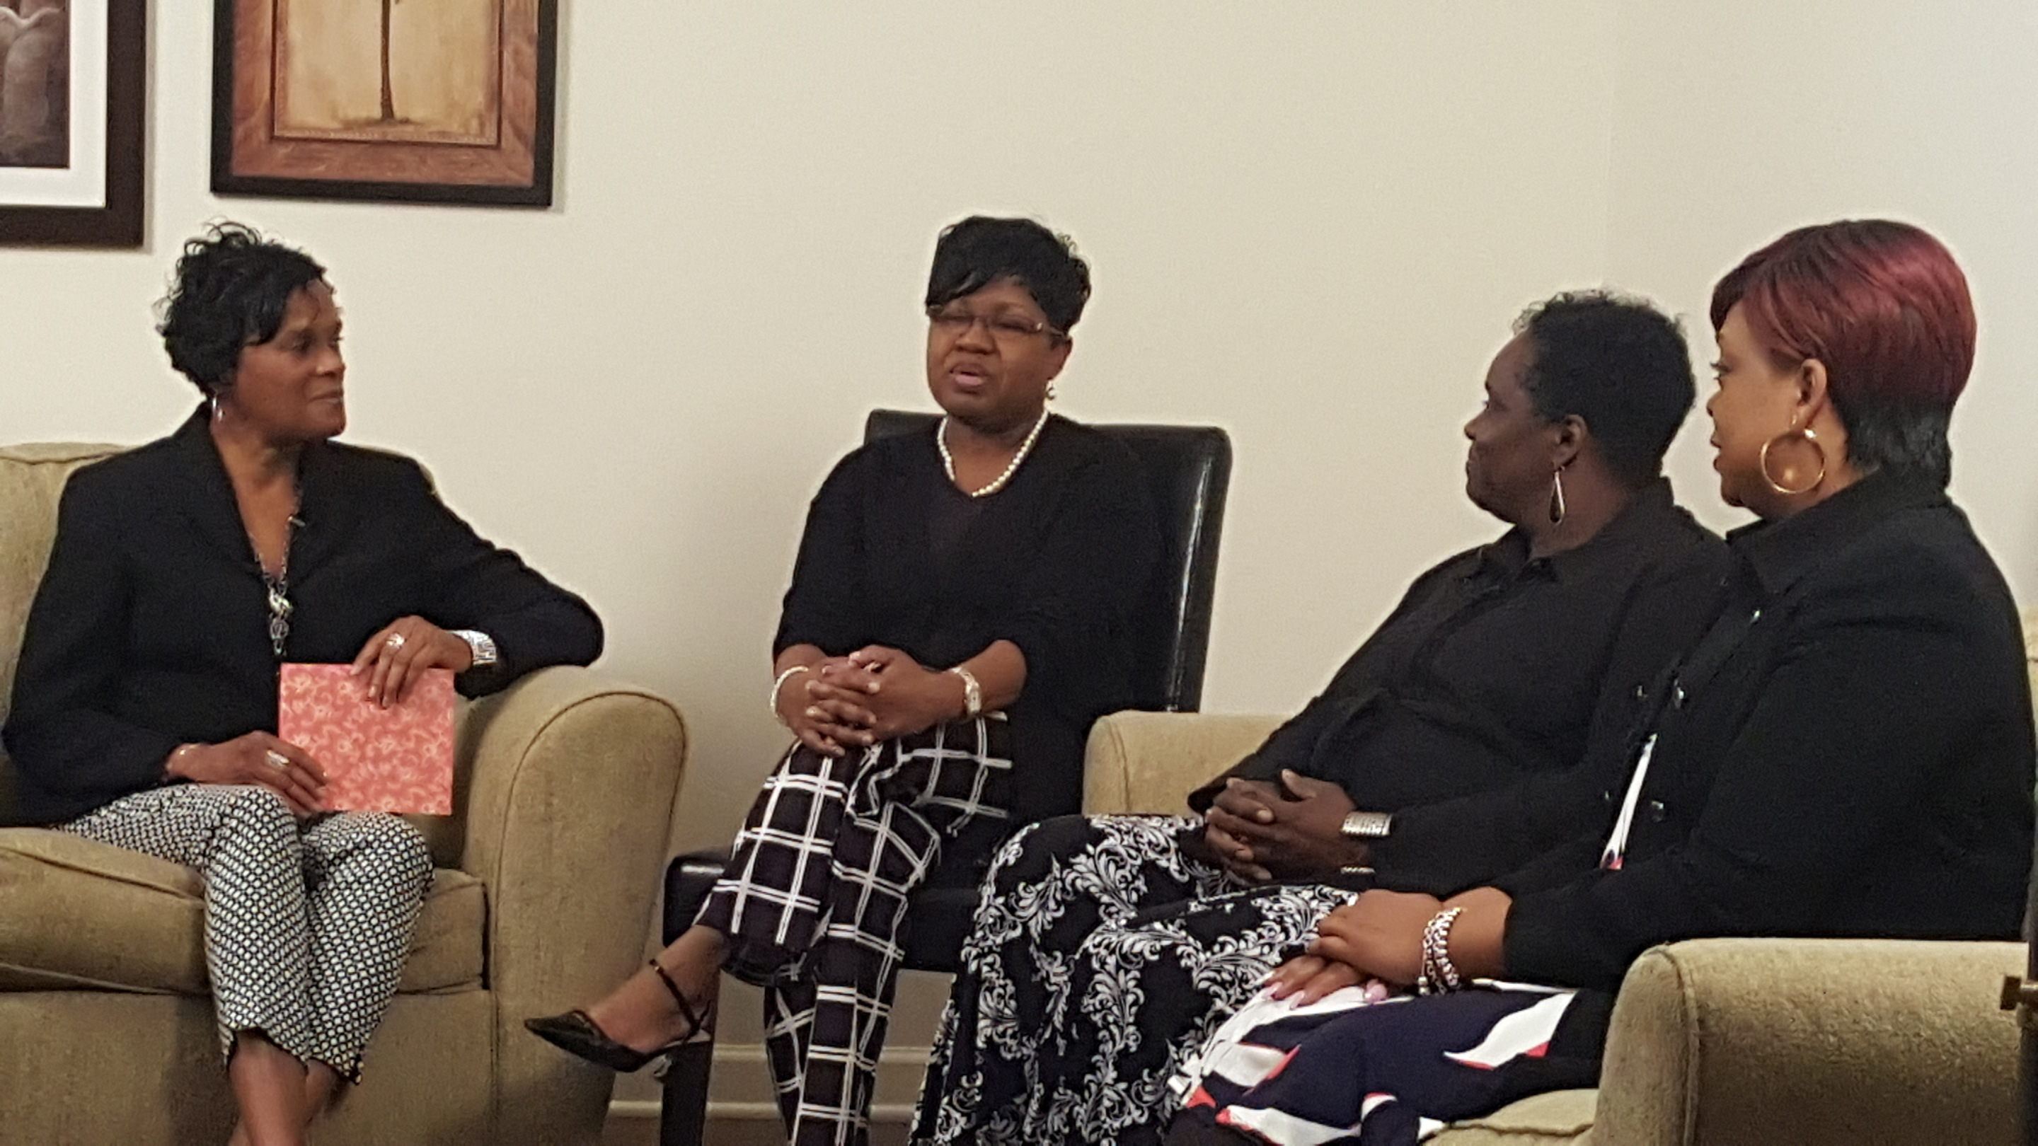
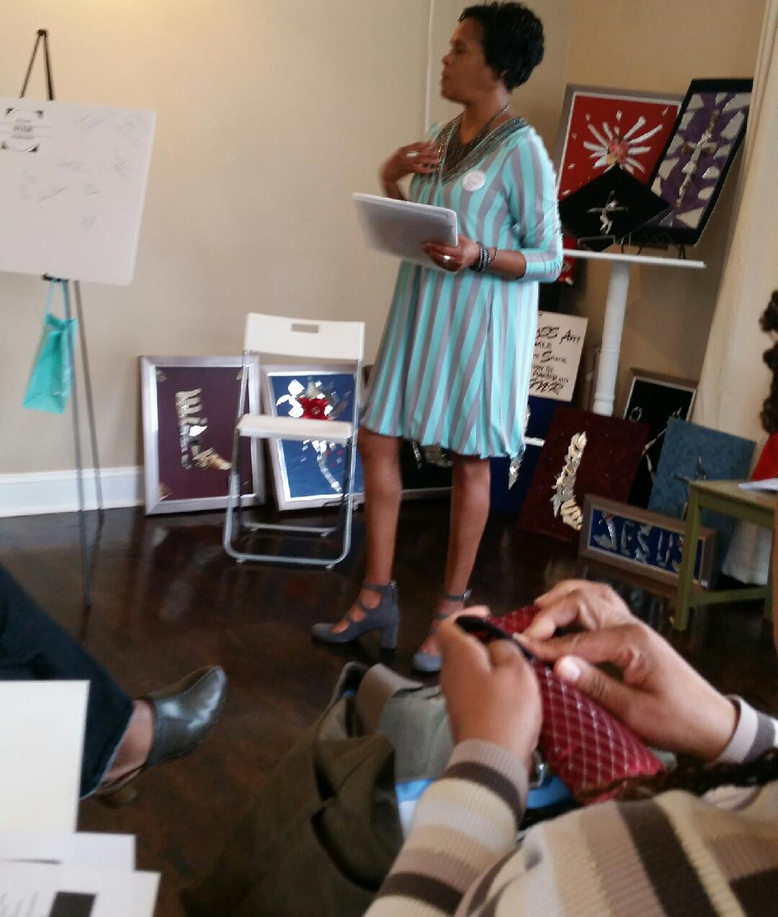
About the Host
This is accomplished by breaking old mental paradigms that have been constructed through traditions, societal programming, culture, church, etc. that have kept so many individuals stuck and living from a limited perspective.
BeU2TheFull encourages individuals to be mentally masterful in their creation of new life experiences.
Janice has authored and published five books, Bruised, Broken and Blessed, Let the Redeemed of the Lord Say So, Unafraid and Fifty: Pushing the Reset Button on Your Life and Don’t Let an Old Person Move into Your Body and other anthology projects.
Janice is the visionary behind BeU2TheFull. She is a Certified Master Life Coach, Author, Writer, Speaker and Board Certified in Metaphysics. Her journey has led her to live more from an awakened perspective through the dismantling of old auto pilot beliefs and programs. Through her renewal process she felt there must be others like her who desire a fresh beginning as well.
BEU2theFull, is the space for that individual to become a better version of themselves so that they can let go of the programming, paradigms, and habitual beliefs that no longer serve the person. The vision is to transform the way individuals have been programmed to think and do life.

Slide 4
RADIO
AIRING LIST
WDJY 99.1 FM | www.wdjyfm.com Station Reach: 425,000 Show Reach 50,000
Fairfax/DC Channel 37 Station Reach: 725,000 BeU2TheFull: 25,000 https://fcac.org/schedule?channel=37
Talk 10 FM Station Reach: 45,00 BeU2TheFull: 8,500 www.talk10FM.com

Slide 5
INVESTMENT PACKAGE
PACKAGE 1 - $100.00
One 50-55 minute radio interview with the Host and future repeated replays on BeU2thefull FM Radio stations.

Slide 6
INVESTMENT PACKAGES
PACKAGE 2 - $85.00
One - 1 minute business, ministry, event ad as a commercial during BeU2theFull episodes for a one-month period. Sponsor will be notified one week prior to the ads being aired on BeU2thefull broadcasts.
Ad content is provided by the sponsor, voice over is performed by a BeU2thefull representative.

Slide 7
Terms
Full payment is required for all packages at the beginning of the agreement with BeU2thefull. ‘
All ads are written by the guest and recorded by a BeU2theFull representative. Guests are also welcome to provide a written and recorded ad directly to BeU2theFull however, the full amount must be paid prior to the ad airing.
All guest interviews are pre-recorded before airing. Host utilizes a professional Musysic microphone and guests are encouraged to utilize Free HD Conference Call which has high definition recording capabilities.

Slide 8
Contact Information
www.beU2thefull.com/FMsponsorships
Janice Thorne | 240-706-1297
IT IS MY PLEASURE TO PARTNER WITH YOU IN SHARING WITH THE WORLD WHAT YOU DO AND HOW YOU ARE MAKING AN IMPACT IN YOUR COMMUNITY.

