Slide 1
Media Kit
With Radio Host, Janice Thorne

Slide 2
The Stunning Side of 60 is a Nationally Syndicated FM Radio show that highlights women or men in their 60’s who blossom and bloom while doing L.I.F.E.
“It’s not over” is an excellent and appropriate way to describe those who are in this quadrant of life. These individuals are redesigning, reinventing and rediscovering a new way of engaging life and they deserve recognition.
The Stunning Side of 60 platform is designed to showcase who they are, what they are doing, and how they are impacting their communities with their knowledge, wisdom and love of life.
Through dynamic interviews, The Stunning Side of 60 will bring inspiration, life principles, exposure to those who are blossoming and blooming in this stage of life and encouragement to others to stay the course.

Slide 3
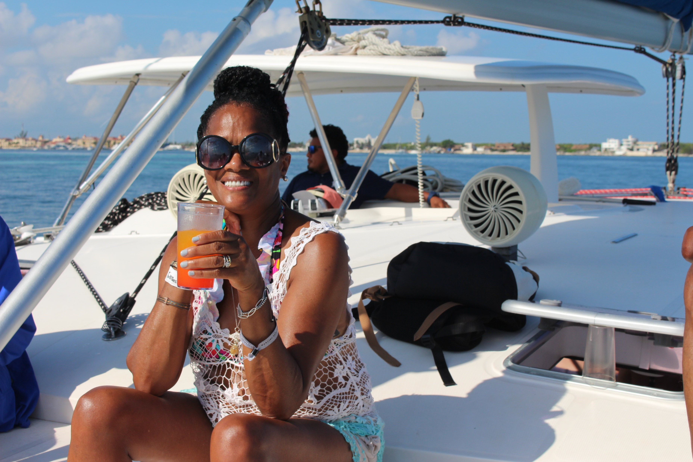
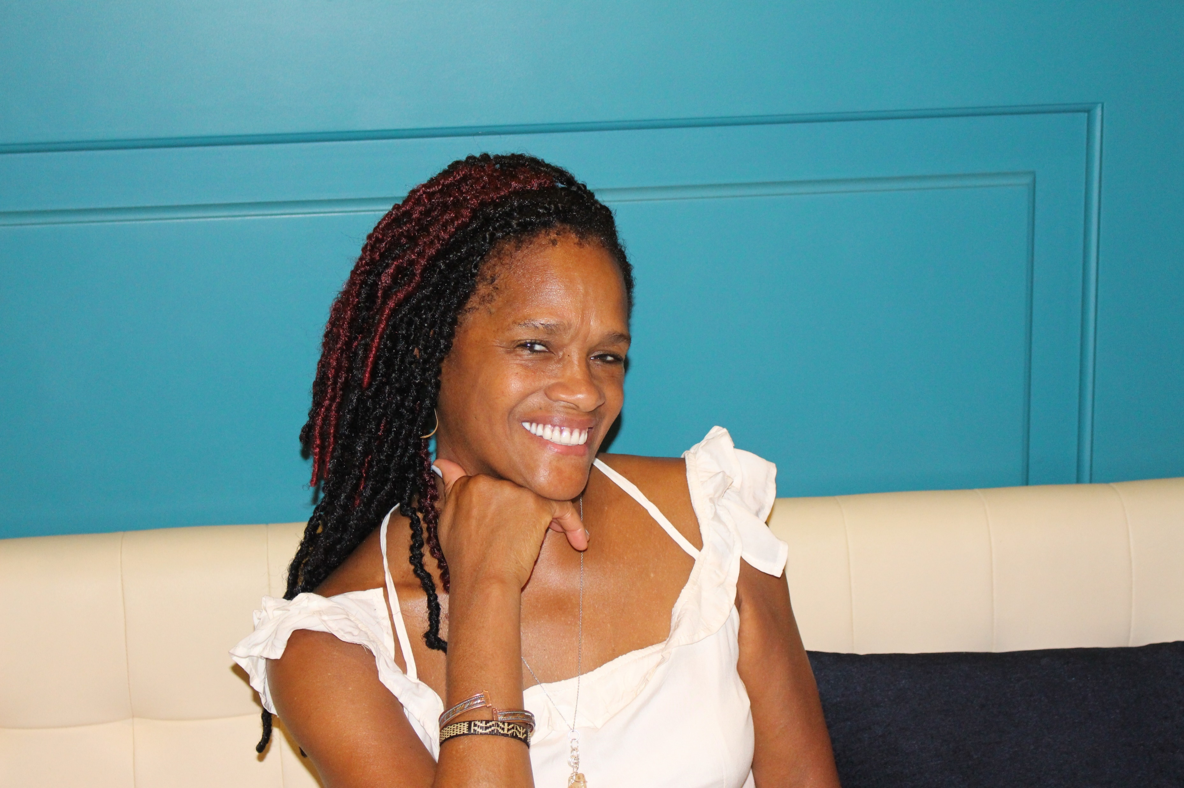
About the Host
Janice is the dynamic radio host of, The Stunning Side of 60.
She is a Certified Master Life Coach, Author, Writer, Speaker and Board Certified in Metaphysics. Her journey as a 60-year young woman has awakened her perspective about life and what is most important to her. Through this awakening process she felt their must be others like her who desire to live more authentically, in control and mentally masterful to achieve what is possible.
Janice is also a FM radio host of 2 other dynamic programs, BeU2theFull and The Tim and Janice Show. She has authored and published four books, Bruised, Broken and Blessed, Let the Redeemed of the Lord Say So, Unafraid and Fifty: Pushing the Reset Button on Your Life and The Joy Tour: Optimum Success in the Workplace. She has also participated on anthology projects that feature her stories.

Slide 4
Radio / Airing Listing
Airs Saturday and Sundays 7:00 – 8:00 p.m. ET
Metro Atlanta, Georgia (Dallas, Hiram, Powder Springs, Douglasville)
Station: WDJY 99.1 FM | wdjyfm.com
Highland Heights, Ohio & Kentucky
Station: WTTA 101.2 FM |wttafm.com
TALK10 | Internet Station only | www.talk10FM.com
Radio Fairfax | https://tunein.com/Radio-Fairfax (airs 4th Wednesday of each month on Community Radio at 8:00 a.m.)

Slide 5
Sponsor Packages
PACKAGE A - $250
Two (2) separate 30-second ads of your product, company, or service (played in various rotations) either at the beginning or the middle of six (6) The Stunning Side of 60 episodes. Sponsor will be notified one week prior to the ads being aired on The Stunning Side of 60 broadcasts.
One 50-55 minute radio interview with the Host.
Promotional snippet of your interview for your website or other platform.
Pre-introduction on Zoom during the month of your scheduled broadcast.
Free admission to ALL The Stunning Side of 60 retreats in 2022. Upcoming retreats for 2022 are in the DC, MD, VA metropolitan area. Note: The Stunning Side of 60 is not responsible for transportation or hotel accommodations, if applicable.

Slide 6
Sponsor Packages
PACKAGE A - $150
One 30-second ad of your product, company, or service either at the beginning or middle of four (4) The Stunning Side of 60 episodes airing nationwide.
One 50-55 minute radio interview with the Host
Targeted promotional “spotlight” posts on social media (Linkedin, Facebook, Instagram) leading up to the scheduled broadcasts.

Slide 7
Terms
The Stunning Side of 60 episodes can contain more than one ad (Package A) as long as there is no competing company, product or service.
Full Payment is required for both packages at the beginning of the agreement with The Stunning Side of 60 Host for the ad and guest interview.
All ads are written by the guest and recorded by a The Stunning Side of 60 representative. Guests are also welcome to provide a written and recorded ad directly to the host.
All guest interviews are pre-recorded before airing. Host utilizes a professional Musysic microphone and guests are encouraged to utilize Free HD Conference Call which has high definition recording capabilities.

Slide 8
IT IS MY PLEASURE TO PARTNER WITH YOU IN SHARING WITH THE WORLD WHAT YOU DO AND HOW YOU ARE MAKING AN IMPACT IN YOUR COMMUNITY.
Contact Information
www.BeU2thefull.com/FMsponsorships
Janice Thorne | 240-706-1297

